Slide 1
Arabic sign language gloves using atmega32
Embedded systems project

Slide 2
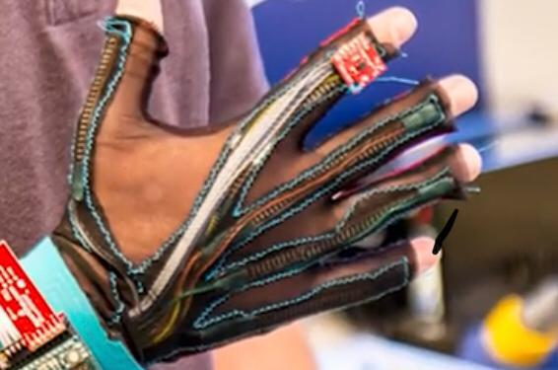

Slide 3
Team members
Abdullah Abubker – atmega programing, group organizer
Mostfa Nabeh – App development ,sharing ideas
Ahmed Helmy - good discussions about the project

Slide 4
Implementation
Using atmega32 with 5 flex sensor ,Adxl335 sensor and Bluetooth module ,and link it with a mobile app that convert the text into speech !

Slide 5
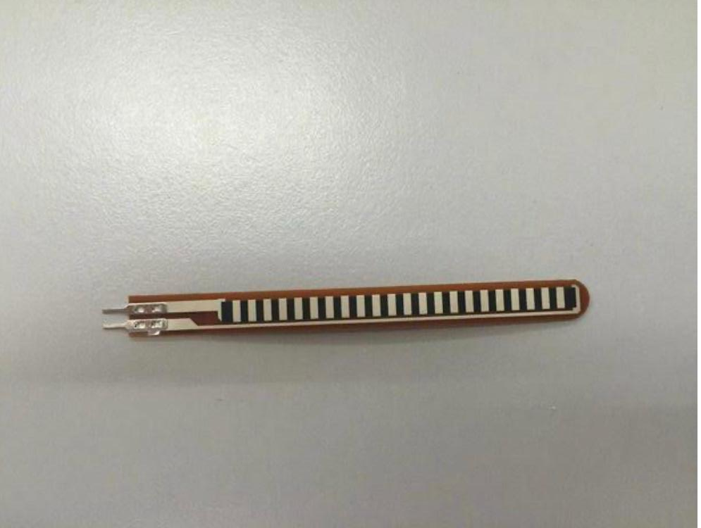
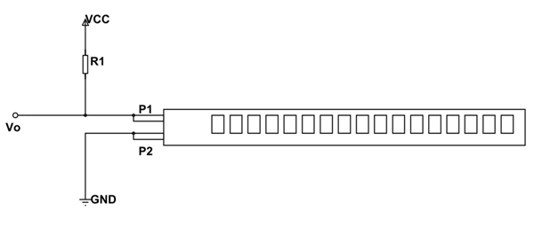
1-Flex sensor

Slide 6
The value of flux sensor moving between 35k and 17k The optimal value of R1 is 50k that gives the widest range of (Vo ) using voltage divider rule , so this will make it easy to detect the difference between litters.

Slide 7
ADc
Adc stands for Analog to Digital convertor , Most real world data is analog. Whether it be pressure, temperature, voltage, etc. their variation is always analog in nature. An embedded system uses the ADC to collect information about the external world (data acquisition system.) The input signal is usually an analog voltage, and the output is a binary number.

Slide 8
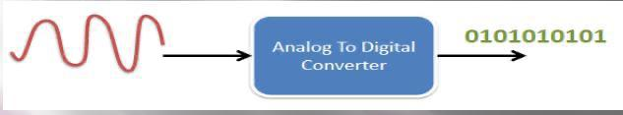
adc
Microcontrollers are meant to deal with digital information. They only understand ’0′ and ’1′ values. So what if we need to get some non-digital data in to microcontroller. The only way is to digitize or simply speaking to convert analog in to digital. This is why almost all microcontrollers are featured with ADC module .

Slide 9
adc
Atmega32 has 8 channels ( 8 pins) for ADC. It is 10 bit resolution (produces 10 bit digital output).•It can hold values from 0 – 1023 ,
We are using 8 pins in this project 5 for flexs and 3 pin for Adxl 335 .

Slide 10
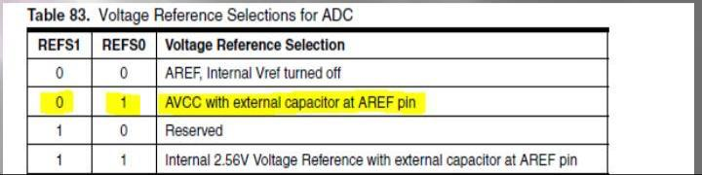
Adc RESOLUTION (STEP)
Resolution (sensitivity):the smallest distinguishable change in input voltage that can be detected. The resolution is the change in input that causes the digital output to change by 1.
This depend on the voltage reference selection from the ADMUX Register .

Slide 11
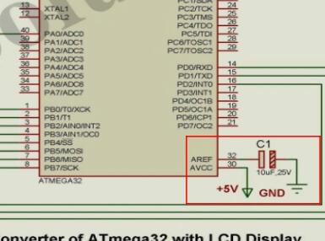
Adc RESOLUTION (STEP)
We are using 5 volts so the step will be
which means that for every 4.88 mv
the adc will count one.

Slide 12
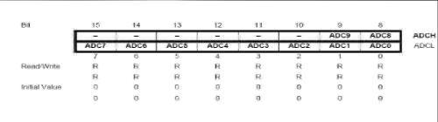
adc
Data RegistersThe result of the ADC conversion is stored here. Since the ADC has a resolution of 10 bits, it requires 10 bits to store the result. Hence one single 8 bit register is not sufficient. We need two registers –ADCL and ADCH (ADC Low byte and ADC High byte) as follows. The two can be called together as ADC.

Slide 13
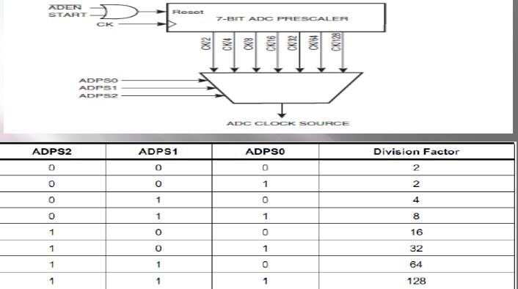
adc
Also you have to set a division factor from ADCSRA Register
we are using
128 division
factor

Slide 14
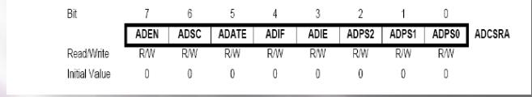
Adc - ADCSRA Register
•Bit 7 –ADEN –ADC EnableAs the name says, it enables the ADC feature. Unless this is enabled, ADC operations cannot take place across PORTA i.e. PORTA will behave as GPIO pins.

Slide 15
Adc - ADCSRA Register
Bit 6 –ADSC –ADC Start ConversionWrite this to ’1′ before starting any conversion. This 1 is written as long as the conversion is in progress, When the conversion is complete, it returns to zero. Normally it takes 13 ADC clock pulses for this operation. But when you call it for the first time, it takes 25 as it performs the initialization together with it

Slide 16
Adc ADCSRA Register
Bit 4 –ADIF –ADC Interrupt FlagThis bit is set when an ADC conversion completes and the Data Registers are updated. The ADC Conversion Complete Interrupt is executed if the ADIE bit and the I-bit in SREG are set. ADIF is cleared by hardware when executing the corresponding interrupt handling vector. Alternatively, ADIF is cleared by writing a logical one to the flag.

Slide 17
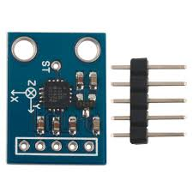
ADXL335 Sensor

Slide 18
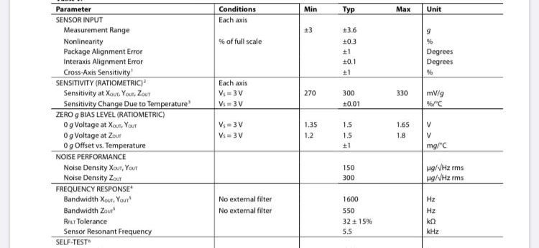
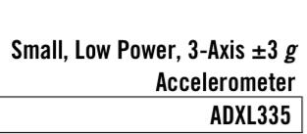
ADXL335 SEnsor
from data sheet

Slide 19
ADXL335 SEnsor
From the data sheet we can see that this sensor is +or- 3g , g is gravity fource , and it as follows +or- 1g at X axis, +or- 1g at Y axis,
+or- 1g at z axis, also we can see that at 0g the output voltage is 1.65 and the sensitivity is 330mv for each 1g ,
for example at -1g on x axis the output voltage will be
1.65v-330 mv =1.32 v . And at +1 will be 1.65v+330 mv =1.98 v

Slide 20
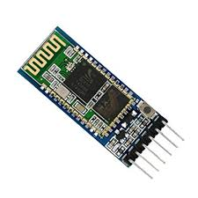
bluetooth module hc-05

Slide 21
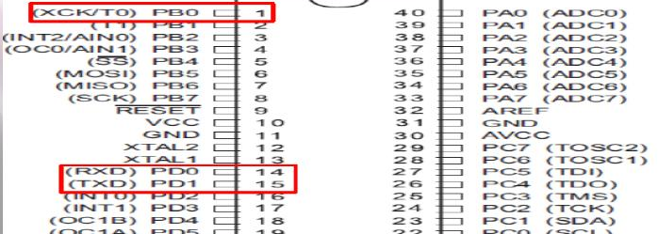
bluetooth module hc-05
We are using USART protocol
USART PIN Configuration ,1-RXD:USART Receiver Pin, 2-TXD:USART Transmit Pin 3- XCK: USART Clock Pin .

Slide 22
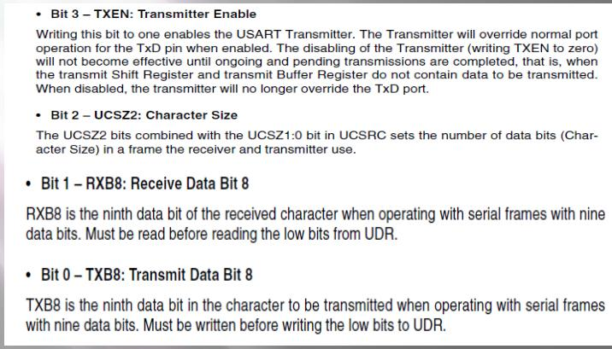
Bluetooth module UCSRB register

Slide 23
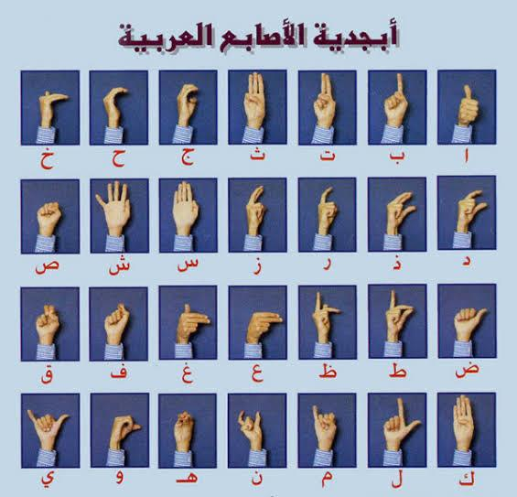
For every letter there ‘s different readings ,so using a lot of if statements
In the code the microcontroller will detect the Arabic letter and will send it to the mobile app using bluetooth module , and the app will convert the text into speech.

Slide 24
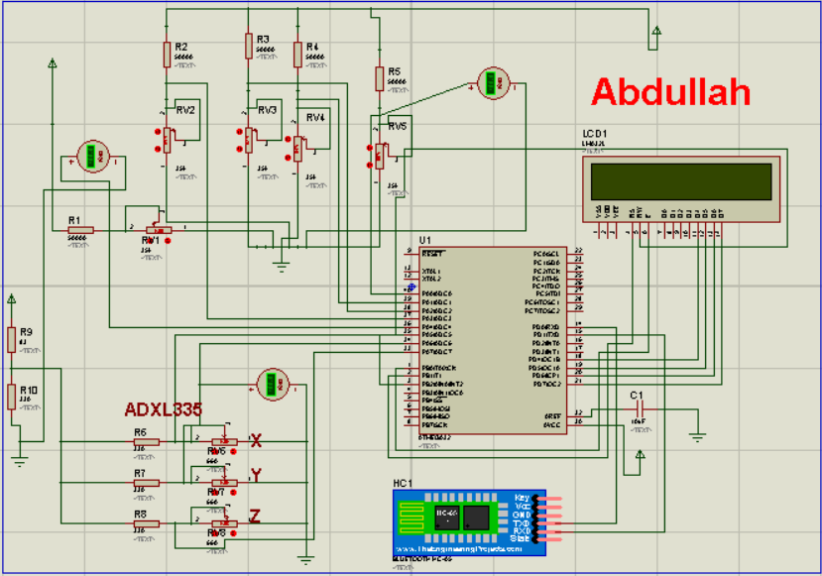
Prototype

Slide 25
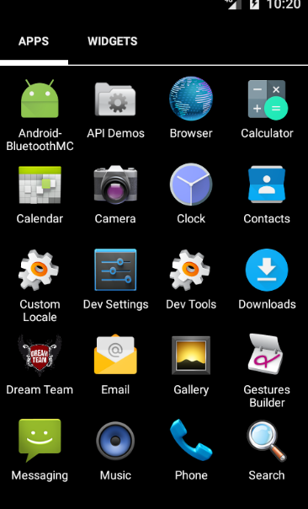
Android logo APP

Slide 26
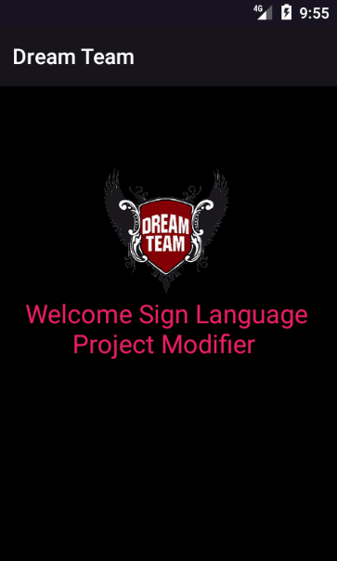
Welcome Screen

Slide 27
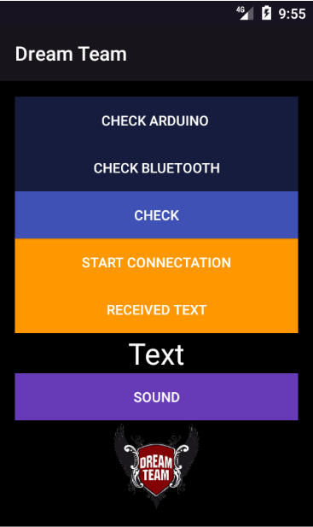
Main Screen

Slide 28
Main Screen(body app)
Check all device around by Bluetooth
Check enable Bluetooth or not
Check button if enable Bluetooth and connotation with device will enable or visible button start connotation and Received Text
Display Text in Text View

Slide 29

Final step
Final step we will convert between text to speech by function text to speech

